Slide 1
Lecture 1:
Environment and Politics in India
Course: Environment and Politics in India

Slide 2
WHAT do we understand by ‘ENVIRONMENT’?
HOW is it related to ‘POLITICS’?

Slide 3
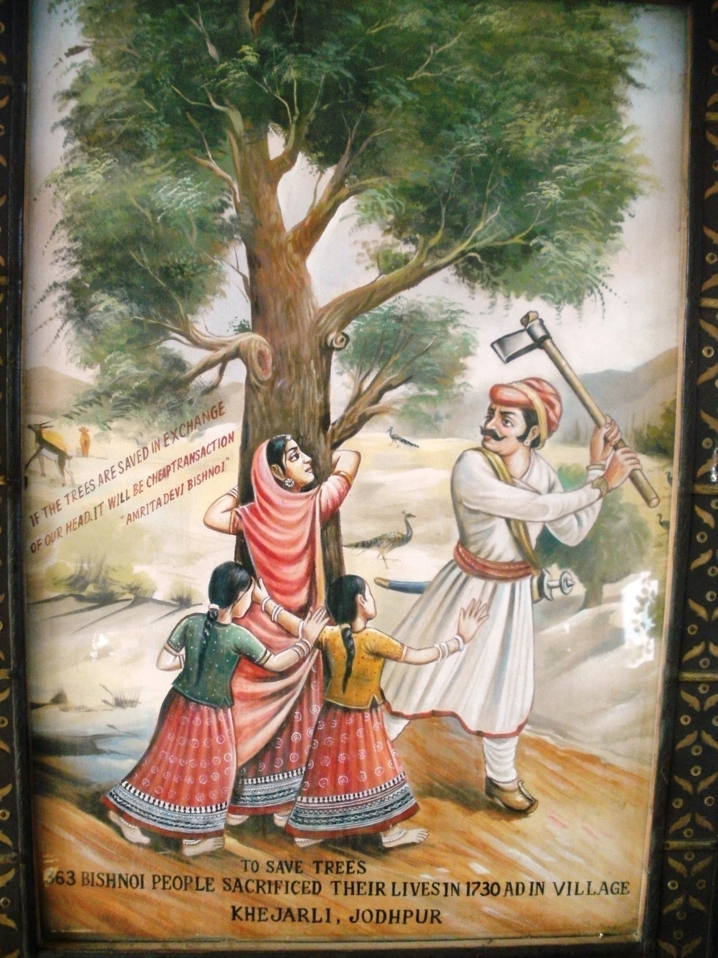

Slide 4
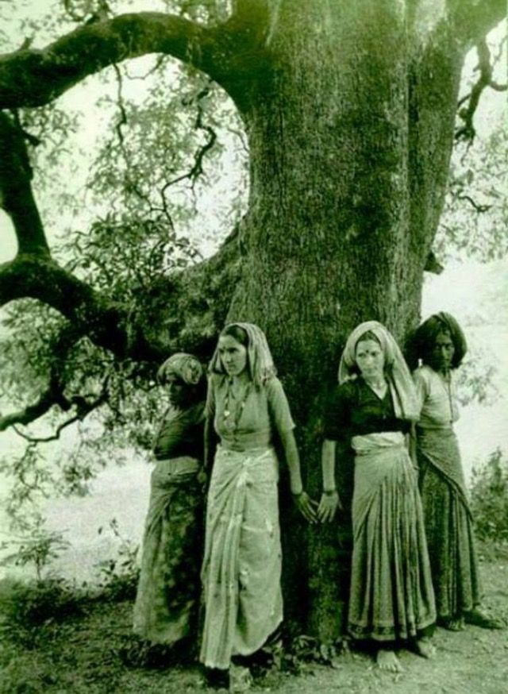

Slide 5
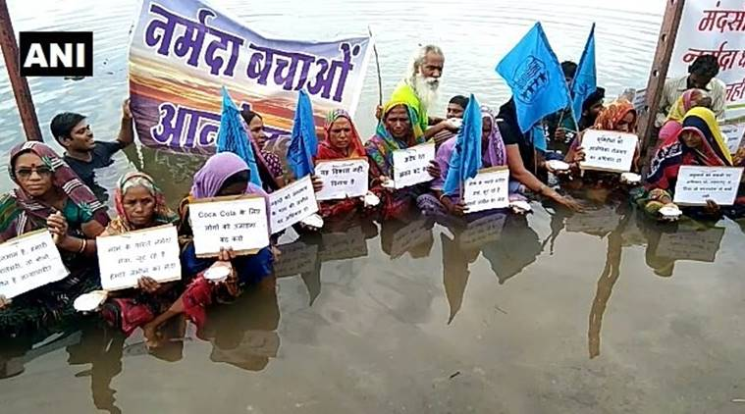

Slide 6


Slide 7
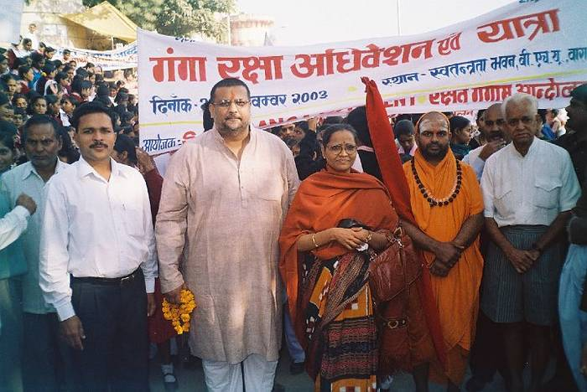
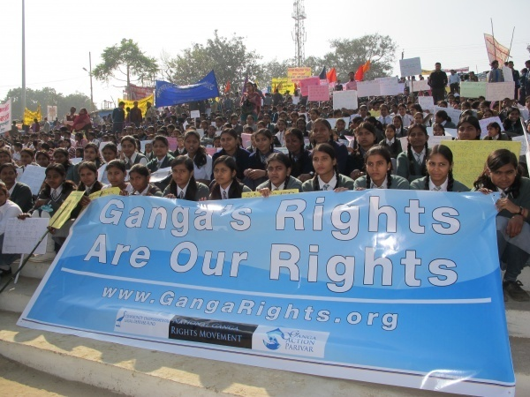

Slide 8
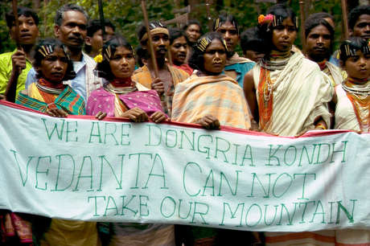

Slide 9
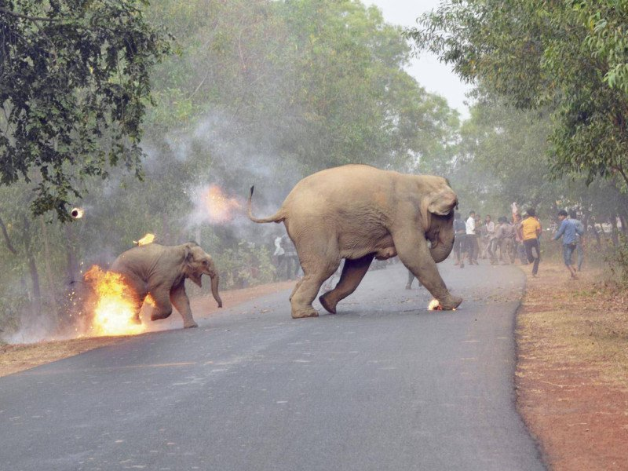

Slide 10
Thinking through the ‘environment’
“Nature! We are encircled and enclasped by her – powerless to depart from her, and powerless to find our way more deeply into her being. Without invitation and without warning she involves us in the orbit of her dance, and drives us onward until we are exhausted and fall from her arm…we live in the midst of her and yet to HER we are alien. She parleys incessantly with us, and to us she does not disclose her secret. We influence her perpetually, and yet we have no power over her”
Goethe
Interdisciplinary nature
Is it possible to think of environmental discourses WITHOUT
  Power and Politics
  Socialism/Equality
  Feminism
  Democracy
  Economics and Economies

Slide 11
About the course
Introduction to Environment. Understanding the interdisciplinary nature of environmental concerns.
Environmental History
  Global environmental history, western models of environmentalism
  Environmental agendas in India. Colonial rule, Shifting environmental discourses/concerns
Environmental Citizenship and Justice
Environmental Legislation and Environmental Discourses
  Regulatory Frameworks/Bodies
  Legislations related to water, air
  Legislations related to forests/land/conservation.
  Eminent Domain principle.
  Climate change negotiations

Slide 12
About the course
  Environmental Politics
    Green Parties in Europe/US
    Environmental agendas in Indian politics
    Red and Green Agendas
    Green and Saffron Agendas
    Dalit Environmentalism
Cultural Ecology
  Social Ecology
  Environmental Discourses and ‘Performing’ Indigeneity
  Cultural Framings and Environmental Resources

Slide 13
Grading pattern
Type of Evaluation | Weightage (in %)
Mid Sem Exam | 20%
End Sem Exam | 40%
Assignments | 40%

Slide 14
About the course
About the tutorials/assignments:
Students will be asked to read articles/material, and write short papers on questions assigned/discussed in the class. At least 5 such tutorials will be conducted.

